Slide 1


CAPSTONE PROJECT
Iran War Oil
2026-Gas Tracker of USA
Presented By
Student Name: Prajukta harichandan
College Name: Siksha 'O' Anusandhan
Department: CSIT
Email ID: Prajuktaha@gmail.com

Slide 2
OUTLINE:
Problem Statement
Proposed System/Solution
System Development Approach
Algorithm & Deployment
Result (Output Image)
Conclusion
Future Scope
References

Slide 3
Problem Statement:
The ongoing 2026 Iran war has triggered a major disruption in global energy and resource markets, affecting oil and natural gas supply chains in world . Critical infrastructure attacks and the partial closure of the Strait of Hormuz—a route resulting for nearly 20% of global oil and gas transport—have reduced supply and increased volatility.
Global oil prices have surged beyond $100–$120 per barrel, with forecasts suggesting further raising spikes depending on the duration of the conflict. Gas prices and LNG supply have also been severely impacted, with some regions experiencing shortages, inflation, and economic instability. Despite the scale of disruption, there is a lack of a centralized, real-time analytical dashboard that tracks and visualizes the impact of the war on gas prices, supply levels, and regional dependencies.

Slide 4
Proposed Solution:
The solution involves building a data-driven Gas Tracker system that integrates historical and near real-time datasets to provide actionable insights on gas prices, supply disruptions, and geopolitical influence. The solution will consist of the following components:
Data Collection:
Gather historical data on recent 2026 real-time data sources.
Depending on 2026 price of January , february and current month march details
Data Preprocessing:
Structuring time-series data in a consistent month format
Handling missing values using tabular and internet statistic resources
Machine Learning Algorithm:
Implement a machine learning algorithm to forecast gas price fluctuations and quantify war impact.
Model performance will be evaluated using standard regression metrics:
Deployment:
Develop a user-friendly interface or application that provides real-time predictions for power BI can fetch predictions dynamically for real-time tracking
Deploy the solution on a scalable and reliable Model outputs (predicted prices) will be exported as structured datasets
Evaluation:
Assess the model's performance using appropriate metrics such as Mean Absolute Error (MAE), Root Mean Squared Error (RMSE), or other relevant metrics.
Accuracy of gas price predictions , Ability to capture volatility caused by war events
Result:

Slide 5
System Approach:
the system follows an analytical architecture, integrating data collection,data processing, machine learning, and visualization to generate actionable insights on gas price fluctuations.
The system operates in the following sequence:
Data Collection → Data Processing → Model Training → Prediction → Visualization → Evaluation
This approach ensures that geopolitical and market data sources is transformed into structured insights and predictive intelligence, enabling effective observation of gas price during crisis conditions.

Slide 6
Algorithm & Deployment:
In the Algorithm section, describe the machine learning algorithm chosen for predicting bike counts. Here's an example structure for this section:
Algorithm Selection: : The problem involves forecasting with external influencing factors (oil prices, supply disruptions, war events). Therefore, two algorithms are selected:
Data Input:
Input taken as Gas Price data, weather conditions,supplu volume, and any other relevant factors , to get the appropriate result
Training Process:
Using current scenario Data Split , Pre orocessing , Model training to learn the pattern by training the model
Prediction Process:
Once the data is read by model it can generate the latest input output of specific data

Slide 7
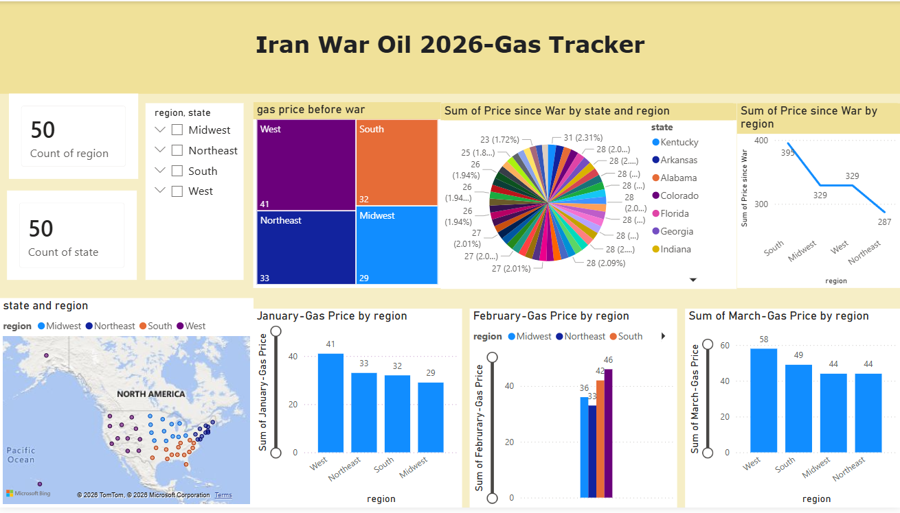
Result:

Slide 8
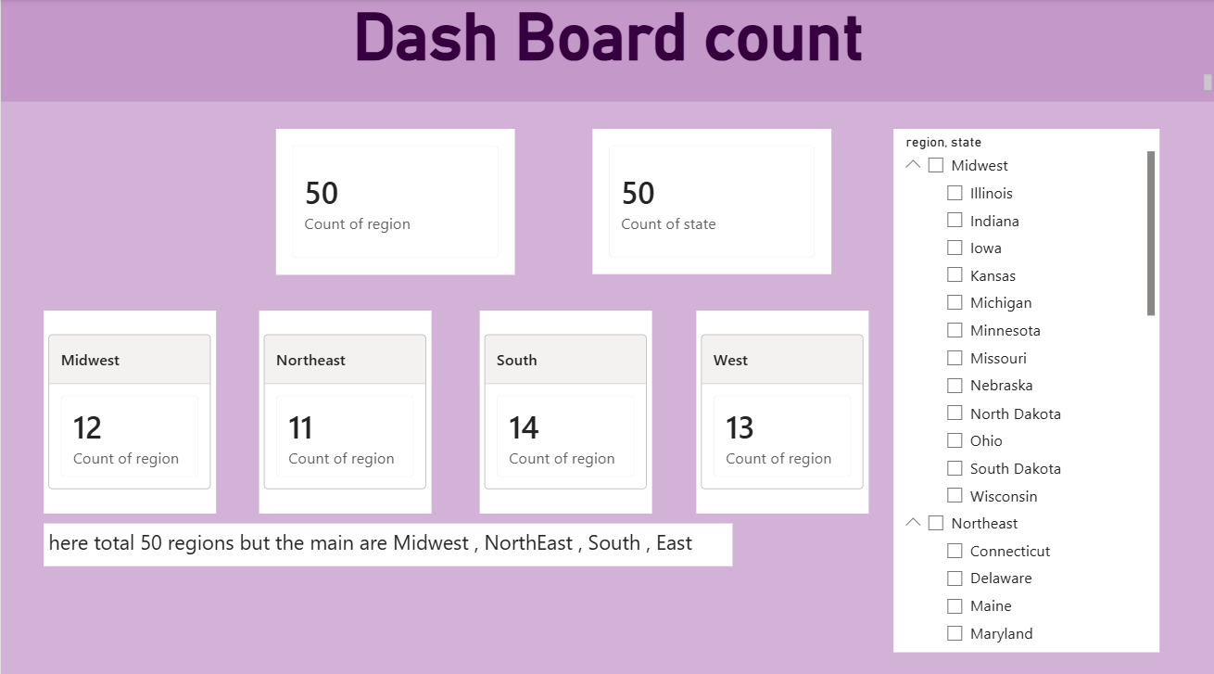
Result:

Slide 9
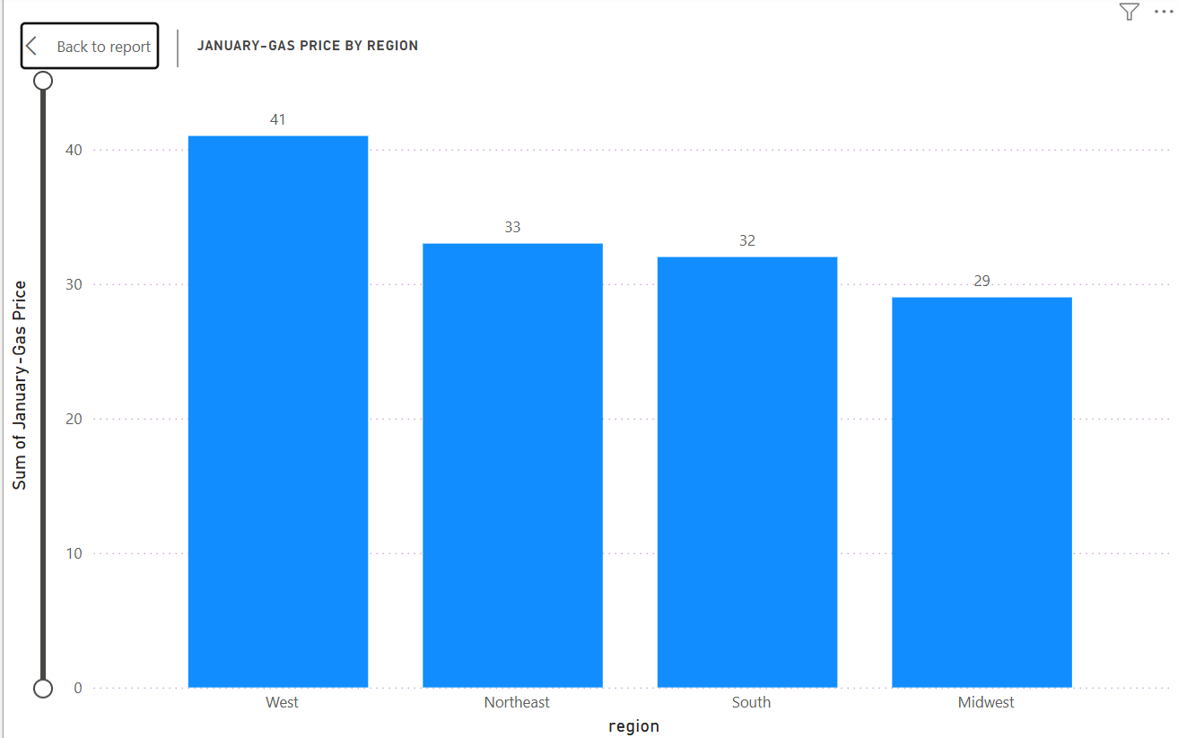
Result: January report

Slide 10
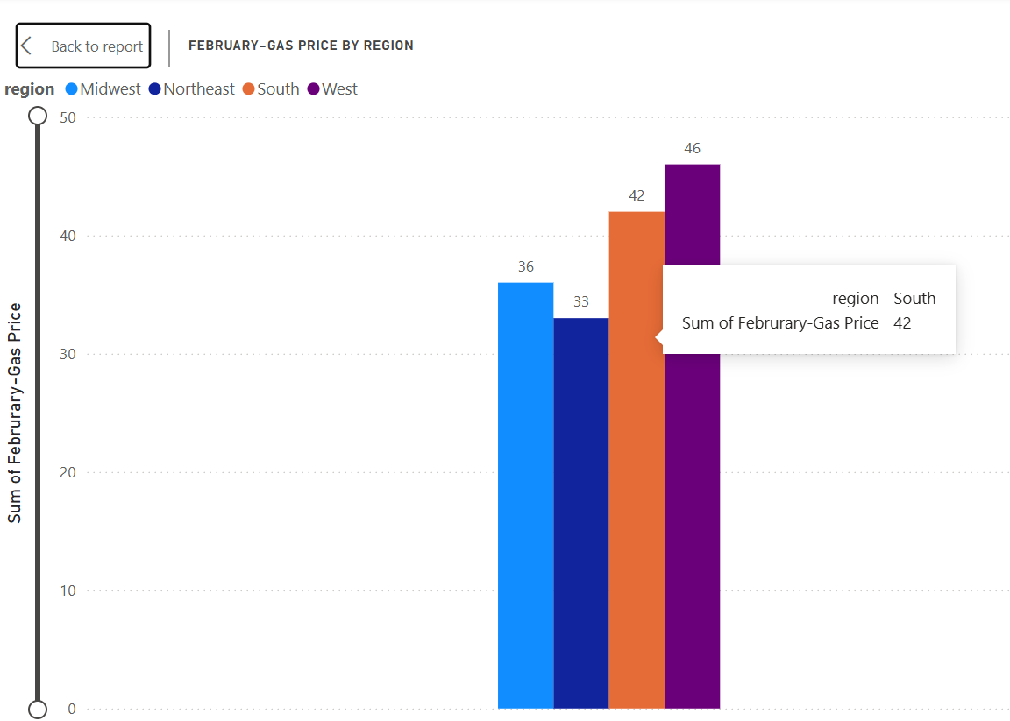
Result: February report

Slide 11
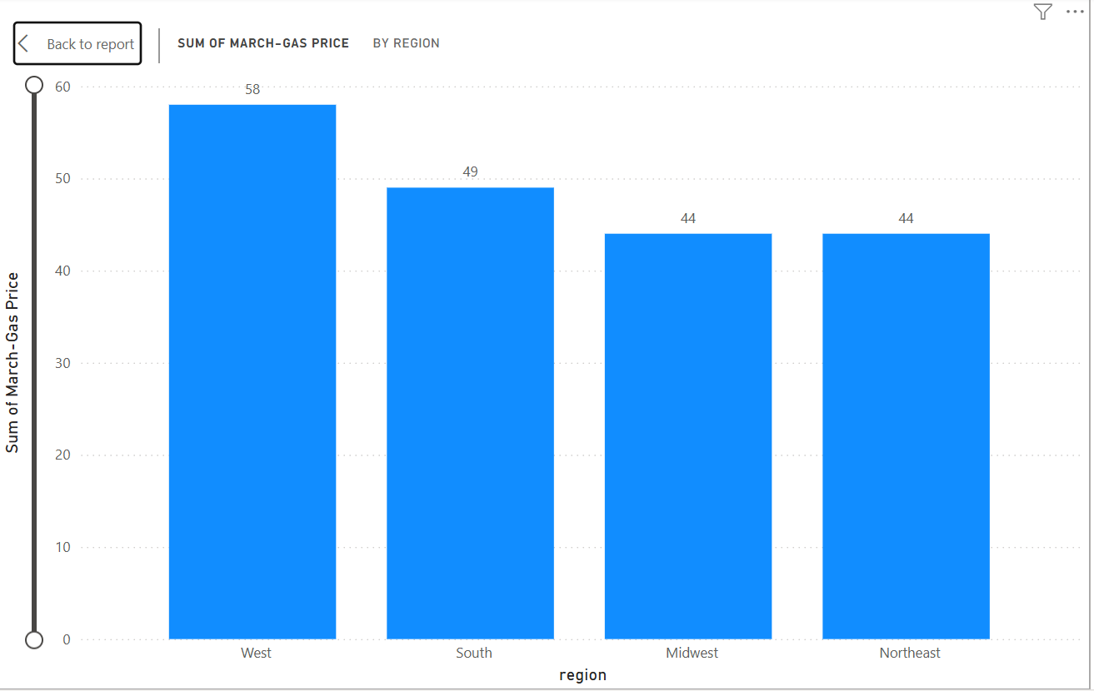
Result: march report

Slide 12
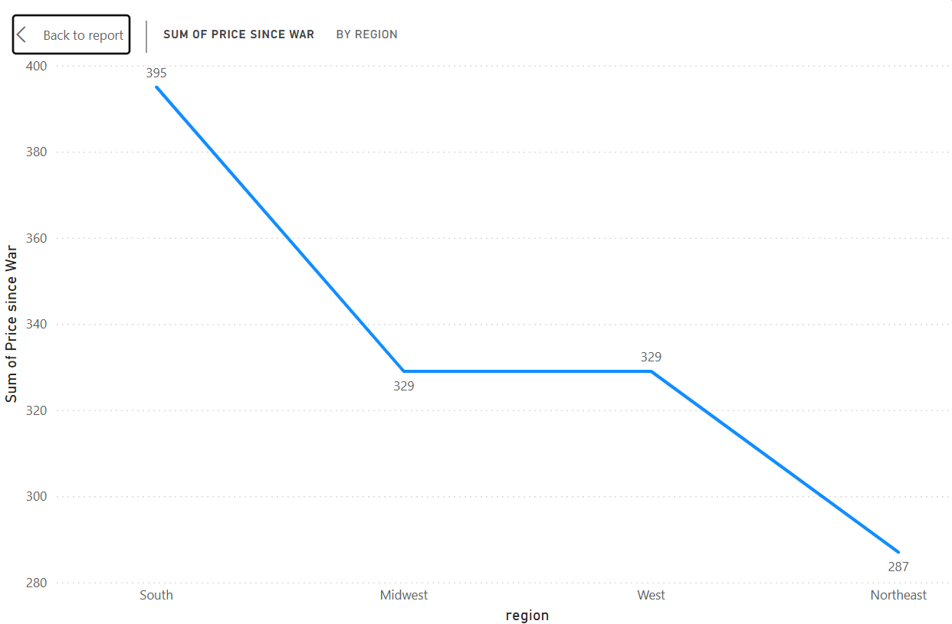
Result: regions faced spike after war

Slide 13
Conclusion:
This project is successfully developed a data analytical and predicting system to study the impact of the 2026 Iran war on gas prices across different regions of the United States during the period of January to March 2026.
The analysis revealed that gas price fluctuations are not uniform across regions, with certain areas experiencing sharper increases due to higher dependency on imports and supply chain disruptions. Regions with stronger infrastructure and diversified energy sources showed relatively lower volatility, while others were more sensitive to geopolitical shocks.
Overall, the project demonstrates that machine learning with intelligence tools can esily transform raw data into an dataful insights, helping analysts understand and respond to regional gas price volatility in the United States during geopolitical disruptions.

Slide 14
Future scope:
The current system focuses on short-term analysis (Jan–Mar 2026); however, it can be significantly expanded to improve accuracy, scalability, and real-world applicability.
The system can evolve into a comprehensive, real-time energy intelligence platform that not only tracks and predicts gas prices but also guides strategic decisions during global geopolitical crises.

Slide 15
References:
Data Set : https://www.kaggle.com/datasets/alitaqishah/iran-war-oil-shock-2026-brent-and-gas-tracker?select=iran_war_key_events_timeline.csv
Software : PowerBI, Power Point , Microsoft Excel.
This dataset was built to create a single, clean, source-verified record of the 2026 Iran oil shock — a structured resource that didn't exist during the fast-moving early weeks of the conflict. Every row links back to a named, verifiable source. Updated daily as the crisis evolves.

Slide 16
Thank You

